Slide 1
CHAPTER 7 the logic of sampling

Slide 2
Chapter Outline
Introduction
A Brief History of Sampling
Nonprobability Sampling
The Logic and Techniques of Probability Sampling
Populations and Sampling Frames
Types of Sampling Designs
Multistage Cluster Sampling
Probability Sampling in Review
The Ethics of Sampling
Chapter Summary
Questions

Slide 3
A Brief History of Sampling
Sampling – The process of selecting observations.
“President” Alf Landon (R)
Literary Digest poll, 1936
Two million ballots mailed to people listed in telephone directory and auto owners
Problems?
“President” Thomas E. Dewey
Gallup’s quota sampling
Problems?

Slide 4
Nonprobability Sampling (slide 1 of 6)
Nonprobability Sampling – Any technique in which samples are selected in some way not suggested by probability theory.
Available subjects
Purposive sampling
Snowball sampling
Quota sampling

Slide 5
Nonprobability Sampling (slide 2 of 6)
Reliance on Available Subjects
Convenience sampling
Does not allow for control over representativeness.
Only justified if less risky methods are unavailable.
Researchers must be very cautious about generalizing when this method is used.
When might this method be appropriate?

Slide 6
Nonprobability Sampling (slide 3 of 6)
Purposive or Judgmental Sampling – A type of nonprobability sampling in which the units to be observed are selected on the basis of the researcher’s judgment about which ones will be the most useful or representative.
Small subsets of a population
Two-group comparison
Deviant cases
When might this method be appropriate?

Slide 7
Nonprobability Sampling (slide 4 of 6)
Snowball Sampling – A nonprobability sampling method whereby each person interviewed may be asked to suggest additional people for interviewing.
Often used in field research, special populations
When might this method be appropriate?

Slide 8
Nonprobability Sampling (slide 5 of 6)
Quota Sampling – A type of nonprobability sampling in which units are selected into a sample on the basis of pre-specified characteristics, so that the total sample will have the same distribution of characteristics assumed to exist in the population being studied.
Similar to probability sampling, but has problems: quota frame must be accurate, selection of sample elements may be biased
When might this method be appropriate?

Slide 9
Nonprobability Sampling (slide 6 of 6)
Selecting Informants
Informant – Someone who is well versed in the social phenomenon that you wish to study and who is willing to tell you what s/he knows about it.

Slide 10
The Logic and Techniques of Probability Sampling
Probability Sampling – The general term for samples selected in accord with probability theory.
Often used for large-scale surveys.
If all members of a population were identical in all respects there would be no need for careful sampling procedures. However, this is rarely the same.
A sample of individuals from a population must contain the same variations that exist in the population.

Slide 11
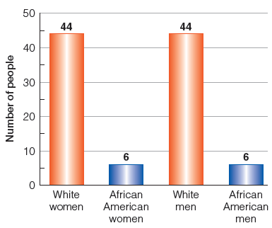
Figure 7-2
A Population of 100 Folks
Typically, sampling aims at reflecting the characteristics and dynamics of large populations. For the purpose of some simple illustrations, let’s assume our total population has only 100 members.

Slide 12
The Logic and Techniques of Probability Sampling
Conscious and Unconscious Sampling Bias
Bias – Those selected are not typical nor representative of the larger population.

Slide 13
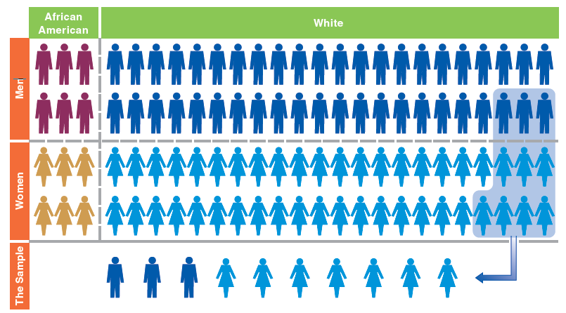
Figure 7-3
A Sample of Convenience: Easy, but Not Representative
Selecting and observing those people who are most readily at hand is the simplest method, perhaps, but it’s unlikely to provide a sample that accurately reflects the total population.

Slide 14
The Logic and Techniques of Probability Sampling (slide 1 of 6)
Representativeness and Probability of Selection
Representativeness – The quality of a sample of having the same distribution of characteristics as the population from which it was selected.
Samples need not be representative in all respects, only those relevant to the research.

Slide 15
The Logic and Techniques of Probability Sampling (slide 2 of 6)
A sample will be representative of the population from which it is selected if all members of the population have an equal chance of being selected in the sample.
EPSEM (Equal Probability of Selection Method)

Slide 16
The Logic and Techniques of Probability Sampling (slide 3 of 6)
Advantages of Probability Sampling
Probability samples are typically more representative than other types of samples because biases are avoided.
Probability theory permits researchers to estimate the accuracy or representativeness of the sample.

Slide 17
The Logic and Techniques of Probability Sampling (slide 4 of 6)
Element – That unit of which a population is composed and which is selected in a sample.
Population – The theoretically specified aggregation of the elements in a study.

Slide 18
The Logic and Techniques of Probability Sampling (slide 5 of 6)
Random Selection – Each element has an equal change of selection independent of any other event in the selection process.

Slide 19
The Logic and Techniques of Probability Sampling (slide 6 of 6)
Probability Theory, Sampling Distributions, and Estimates of Sampling Error
Parameters and Statistics
Parameter – A summary description of a given variable in a population.

Slide 20

Figure 7-4
A Population of 10 People with $0-$9
Let’s imagine a population of only 10 people with differing amounts of money in their pockets—ranging from $0-$9.

Slide 21
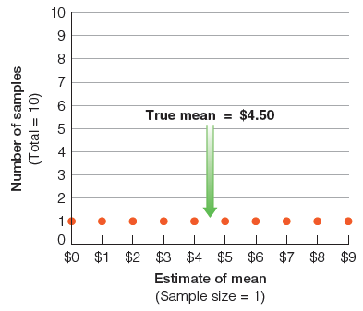
Figure 7-5
The Sampling Distribution of Samples of 1
In this simple example, the mean amount of money these people have is $4.50 ($45/10). If we picked 10 different samples of 1 person each, our “estimates” of the mean would range all across the board.

Slide 22
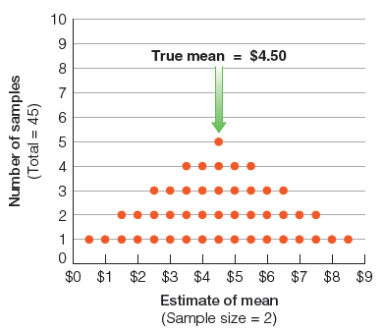
Figure 7-6
The Sampling Distribution of Samples of 2
After merely increasing our sample size to 2, the possible samples provide somewhat better estimates of the mean. We couldn’t get either $0 or $9, and the estimates are beginning to cluster around the true value of the mean: $4.50.

Slide 23
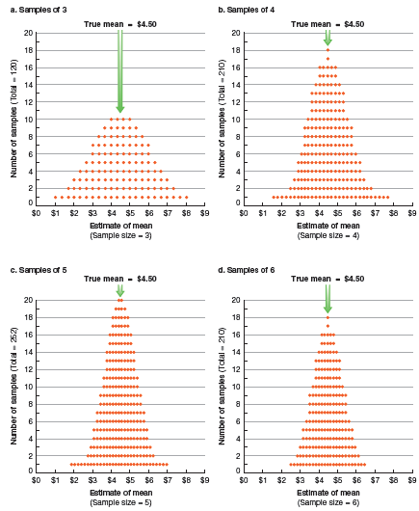
Figure 7-7
The Sampling Distributions of Samples of 3, 4, 5, and 6
As we increase the sample size, the possible samples cluster ever more tightly around the true value of the mean. The chance of extremely inaccurate estimates is reduced at the two ends of the distribution, and the percentage of the samples near the true value keeps increasing.

Slide 24
The Logic and Techniques of Probability Sampling
Statistic – the summary description of a variable in a sample, used to estimate a population parameter.
Sampling Error – The degree of error to be expected of a given sample design.

Slide 25

Figure 7-8
Range of Possible Sample Study Results
Shifting to a more realistic example, let’s assume that we want to sample student attitudes concerning a proposed conduct code. Let’s assume that 50 percent disapproves—though the researcher doesn’t know that.

Slide 26
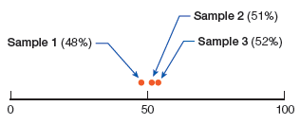
Figure 7-9
Results Produced by Three Hypothetical Studies
Assuming a large student body, let’s suppose that we selected three different samples, each of substantial size. We would not necessarily expect those samples to perfectly reflect attitudes in the whole student body, but they should come reasonably close.

Slide 27
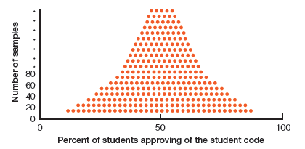
Figure 7-10
The Sampling Distribution
If we were to select a large number of good samples, we would expect them to cluster around the true value (50 percent), but given enough such samples, a few would fall far from the mark.

Slide 28
The Logic and Techniques of Probability Sampling
Confidence Levels and Confidence Intervals
Confidence Level – The estimated probability that a population parameter lies within a given confidence interval.
Confidence Interval – The range of values within which a population parameter is estimated to lie.

Slide 29
Populations and Sampling Frames (slide 1 of 2)
Sampling Frame – A list of units composing a population from which a sample is selected.
If the sample is to be representative of the population, it is essential that the sampling frame include all members of the population.

Slide 30
Populations and Sampling Frames (slide 2 of 2)
Guidelines for Populations and Sampling Frames
Findings based on a sample represent only the aggregation of elements that compose the sampling frame.
Sampling frames do not include all the elements their names might imply. Omissions are inevitable.
To be generalized, all elements must have equal representation in the frame.

Slide 31
Types of Sampling Designs (slide 1 of 2)
Simple Random Sampling
Systematic Sampling
Stratified Sampling
Implicit Stratification in Systematic Sampling

Slide 32
Types of Sampling Designs (slide 2 of 2)
Simple Random Sampling – A type of probability sampling in which the units composing a population are assigned numbers. A set of random numbers is generated and the units having those numbers are included in the sample.
Not necessarily the most accurate sampling method.

Slide 33
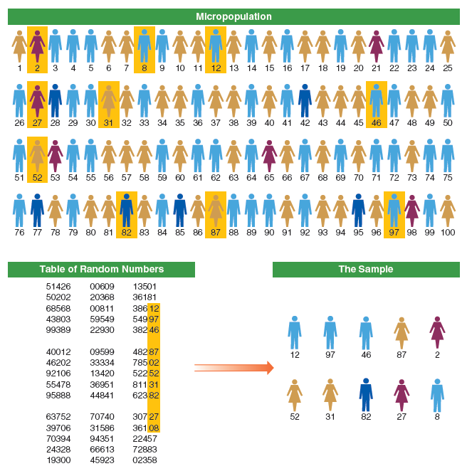
Figure 7-11
A Simple Random Sample
Having numbered everyone in the population, we can use a table of random numbers to select a representative sample from the overall population. Anyone whose number is chosen from the table is in the sample.

Slide 34
Types of Sampling Designs (slide 1 of 3)
Systematic Sampling – A type of probability sampling in which every k^{th} unit in a list is selected for inclusion in the sample.
Slightly more accurate than simple random sampling.

Slide 35
Types of Sampling Designs (slide 2 of 3)
Sampling Interval – The standard distance between elements selected from a population in the sample.
Sampling Ratio – the proportion of elements in the population that are selected to be in a sample.

Slide 36
Types of Sampling Designs (slide 3 of 3)
Stratified Sampling
Stratification – The grouping of the units composing a population into homogenous groups (strata) before sampling.
Slightly more accurate than simple random sampling.
Stratification is a modification to simple random and systematic sample methods.

Slide 37
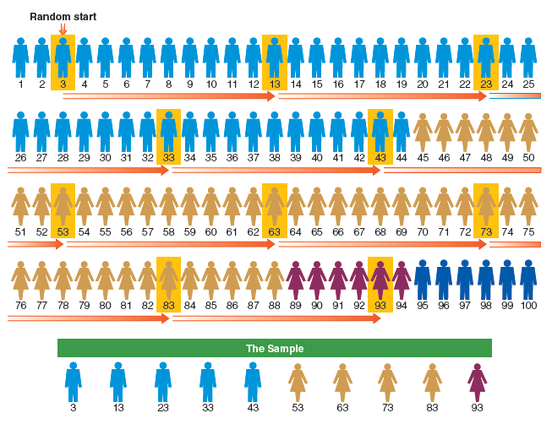
Figure 7-12
A Stratified, Systematic Sample with a Random Start
A stratified, systematic sample involves two stages. First the members of the population are gathered into homogeneous strata; this simple example merely uses gender and race as stratification variables, but more could be used. Then every kth (in this case, every tenth) person in the stratified arrangement is selected into the sample.

Slide 38
Types of Sampling Designs
Implicit Stratification in Systematic Sampling
Illustration: Sampling University Students
Sampling Modification

Slide 39
Multistage Cluster Sampling
Cluster Sampling – A multistage sampling in which natural groups are sampled initially with the members of each selected group being sub-sampled afterward.
Used when it is not practical or possible to create a list of all elements that compose the target population.
Highly efficient, but less accurate.

Slide 40
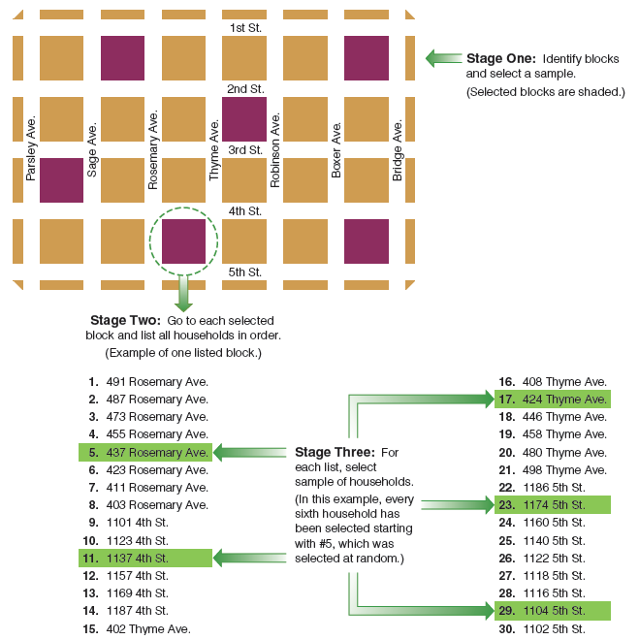
Figure 7-13
Multistage Cluster Sampling
In multistage cluster sampling, we begin by selecting a sample of the clusters (in this case, city blocks). Then, we make a list of the elements (households, in this case) and select a sample of elements from each of the selected clusters.

Slide 41
Multistage Cluster Sampling (slide 2 of 2)
Disproportionate Sampling and Weighting
Weighting – Assigning different weights to cases that were selected into a sample with different probabilities of selection.

Slide 42
Probability Sampling in Review
Remains the most effective method for selection of study elements because:
Allows researchers to avoid biases in element selection
Permits estimates of error

Slide 43
The Ethics of Sampling
When nonprobability-sampling methods are used, researchers must take care not to mislead readers into confusing variations with what’s typical in the population.

Slide 44
Chapter Summary (slide 1 of 2)
Be able to highlight some of the key events in the development of sampling in social research.
Describe what is meant by “nonprobability sampling” and identify several techniques.
Identify and explain the key elements in probability sampling.
Explain the relationship between populations and sampling frames in social research.

Slide 45
Chapter Summary (slide 2 of 2)
Identify and describe several types of probability sampling designs.
Describe the steps involved in selecting a multistage cluster sample.
Discuss the key advantages of probability sampling.
Explain how the sampling design of a study could have ethical implications.

